Slide 1
CSE-299
Presentation Week : 01
“Project Idea Presentation”
Presenting by : Group -1
Date : 23/07/2020

Slide 2
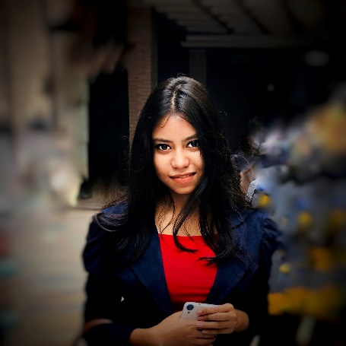
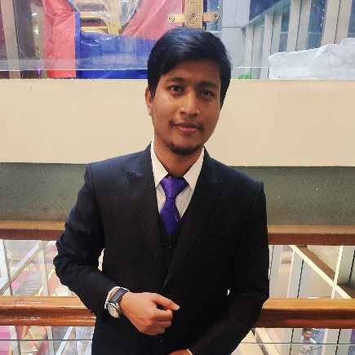
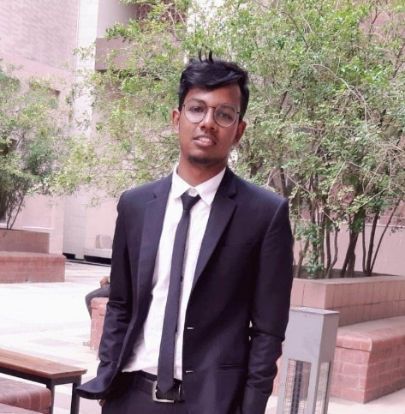
Group Information
01
02
03
Polin Rahman
Md Iftehad Amjad Chy
Ahmed Rifat
ID : 1531377042
ID : 1612547042
ID : 1620746042
Email :
polin.rahman@northsouth.edu
Email :
iftehad.chy@northsouth.edu
Email :
ahmed.rifat@northsouth.edu

Slide 3

Discussion Outline
Project Title
Project Purpose
Our Proposal
How it’s work
Application Overview
Work Cycle
Conclusion
Q/A Section

Slide 4

Project Title
Dietary: a Cloud-based Nutriment & Fitness Assistant(fact-based) Android App for Bangladeshi Youths.
Its mainly a nutrition & fitness guideline providing application. Its main audience is young people.
Also, focusing on user practical life situations.

Slide 5

Project Purpose
What is the purpose
of this project?
In case of food & nutrition
Currently Bangladeshi people specially Youths have
- No food plan according to BMI
- Complex calorie counting
- No practical diet chart
- Knowledge gap
Busy life schedule
Unhealthy food habit
Non-Communicable Diseases (NCDs)
In case of fitness
- Busy life
- Procrastination
- Unable to effort Gym or trainer
- Lack of knowledge
When it’s about healthy a lifestyle, Yes…
There is a lot of carelessness and also, suffering from some points.

Slide 6
What we propose?
Our main focus on Youth's
That’s why we are proposing :
a Cloud-based Nutrition & Fitness Android Application
Fitness
Nutrition
Cloud services
- Authentication
- RTD
- Cloud storage
Nutrition guideline
Fitness guideline
User helping hand

Slide 7














How it’s work
BMI Calculator
Login or
Sign-Up
Diet Plan
User
Nutrition Assistant
Regular life-based
Busy life-based
Fitness Assistant
Need to connect with
Wi-Fi or
Mobile data
User Manual
Connected with
Cloud-storage
Chatbot
User Assistant
Basic Q/A

Slide 8

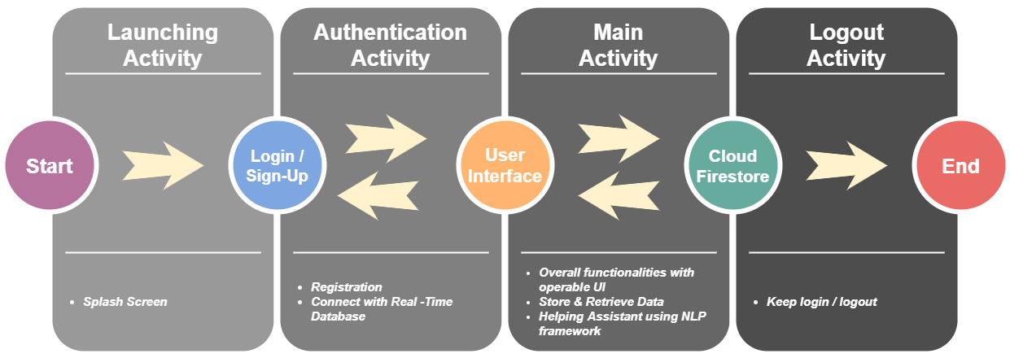

Application Overview
Successfully
terminate the process
User can also take an overview of this app & experience some features without register.

Slide 9


Work Cycle
Week : 04
Backend support
Week : 05
Week : 07
Database connection
Store data
Retrieve data
Nutrition assistant
User assistant
Week : 02
BMI Calculator
Diet Plan
User manual
Basic Q/A using Chatbot
Background study
Similar work
Scholar articles
Tools & Framework
Week : 03
Week : 06
Authentication
Fitness assistant
Login
Signup
Week 08
Final Presentation
Guideline according to
Regular life based
Busy life based

Slide 10
Conclusion
Nothing can be better than a good health & immunity system.
Easy operable Android app
Gives food plan based on BMI
Young's are considered much healthier but they also need attestation.
Suggests workout plan based on Lifestyle
User manual
Basic Q/A using Chatbot
Typical diet & workout not always applicable for all.

Slide 11



That’s all for today’s presentation…..
Any Questions?
or
Suggestions!

